Slide 1
Practical course “Parallel Numerical Methods” 2020/21
Presenter - Shreyas Gururaj
Mentor - Prof. Dr. Mario Bebendorf
Student ID - 1750040

Slide 2






Topics to be discussed
Setting up the environment.
Good coding practices and documentation.
Sequence of implementation of the PNLA Library.
Unit testing, PCG Algorithm, Open MP Implementation.
Observations and results.
Experiences and lessons learned.

Slide 3
Setting up the environment
Local machine
VPN(Cisco AnyConnect)
Git-hub
Created repo and branches
Remote Linux Machine
Visual studio code
HPC_ENB Cluster
Slurm workload manager

Slide 4
Good coding practices and documentation
Emphasis given to proper naming conventions.
Easy to debug and maintain.
Doxygen used for documentation
A well - structured code and folder structure
CMake for building and automated testing
Code for the end user.

Slide 5
Sequence of implementation of the PNLA Library
PCG Algorithm
CRS
Matrix routines
Vector Routines

Slide 6
Unit testing
PCG algorithm tested on Poisson 2d problem on a unit square
All the test routines implemented keeping in mind the further parallelization.
CRS Matrix test routines
All the tests were independent of the input dimensions.
Vector test routines
All the tests were independent of each other.

Slide 7
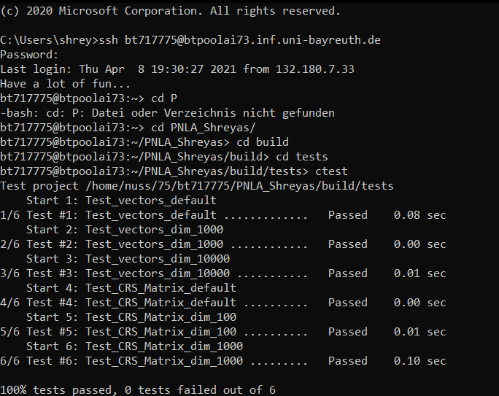
Unit testing Results
Both the sequential and Open MP implementation tested separately before implementing PCG algorithm.

Slide 8
PCG Algorithm
while(residue > relative accuracy or iter < max_iter)
Used Identity as preconditioner.
Compute coefficients alpha, rho and gamma.
Update residue
Increment iter

Slide 9
Open MP Implementation
Changes made from the sequential implementation
Changed the std::vector methods to “unique_ptr” and “shared_ptr” implementation to reduce the linear complexity to constant complexity during allocation and assignment. (Amdahl’s Law applies)
Parallelized the for loops for all the vector and CRS matrix routines. The time taken for each routine is clocked before and after the function call.
Template function instantiation wherever required with OMP structs and variables to accommodate for the Open MP implementation in already defined test routines.

Slide 10
We can now shift our attention to some interesting stuff.

Slide 11
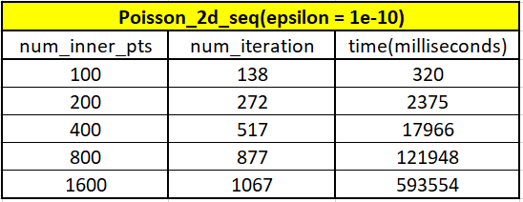
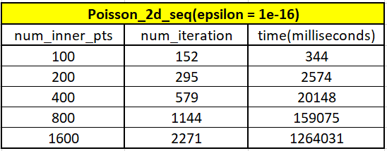
Observations and results
1. Effect of epsilon (Considered for sequential case.)

Slide 12
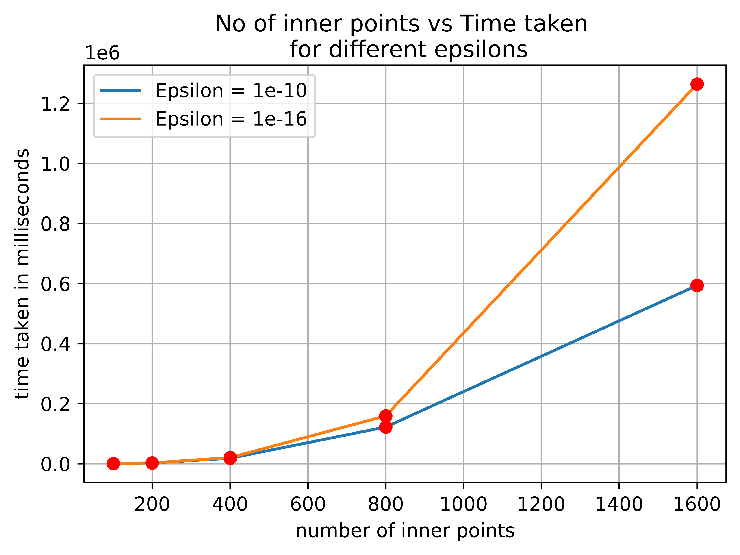
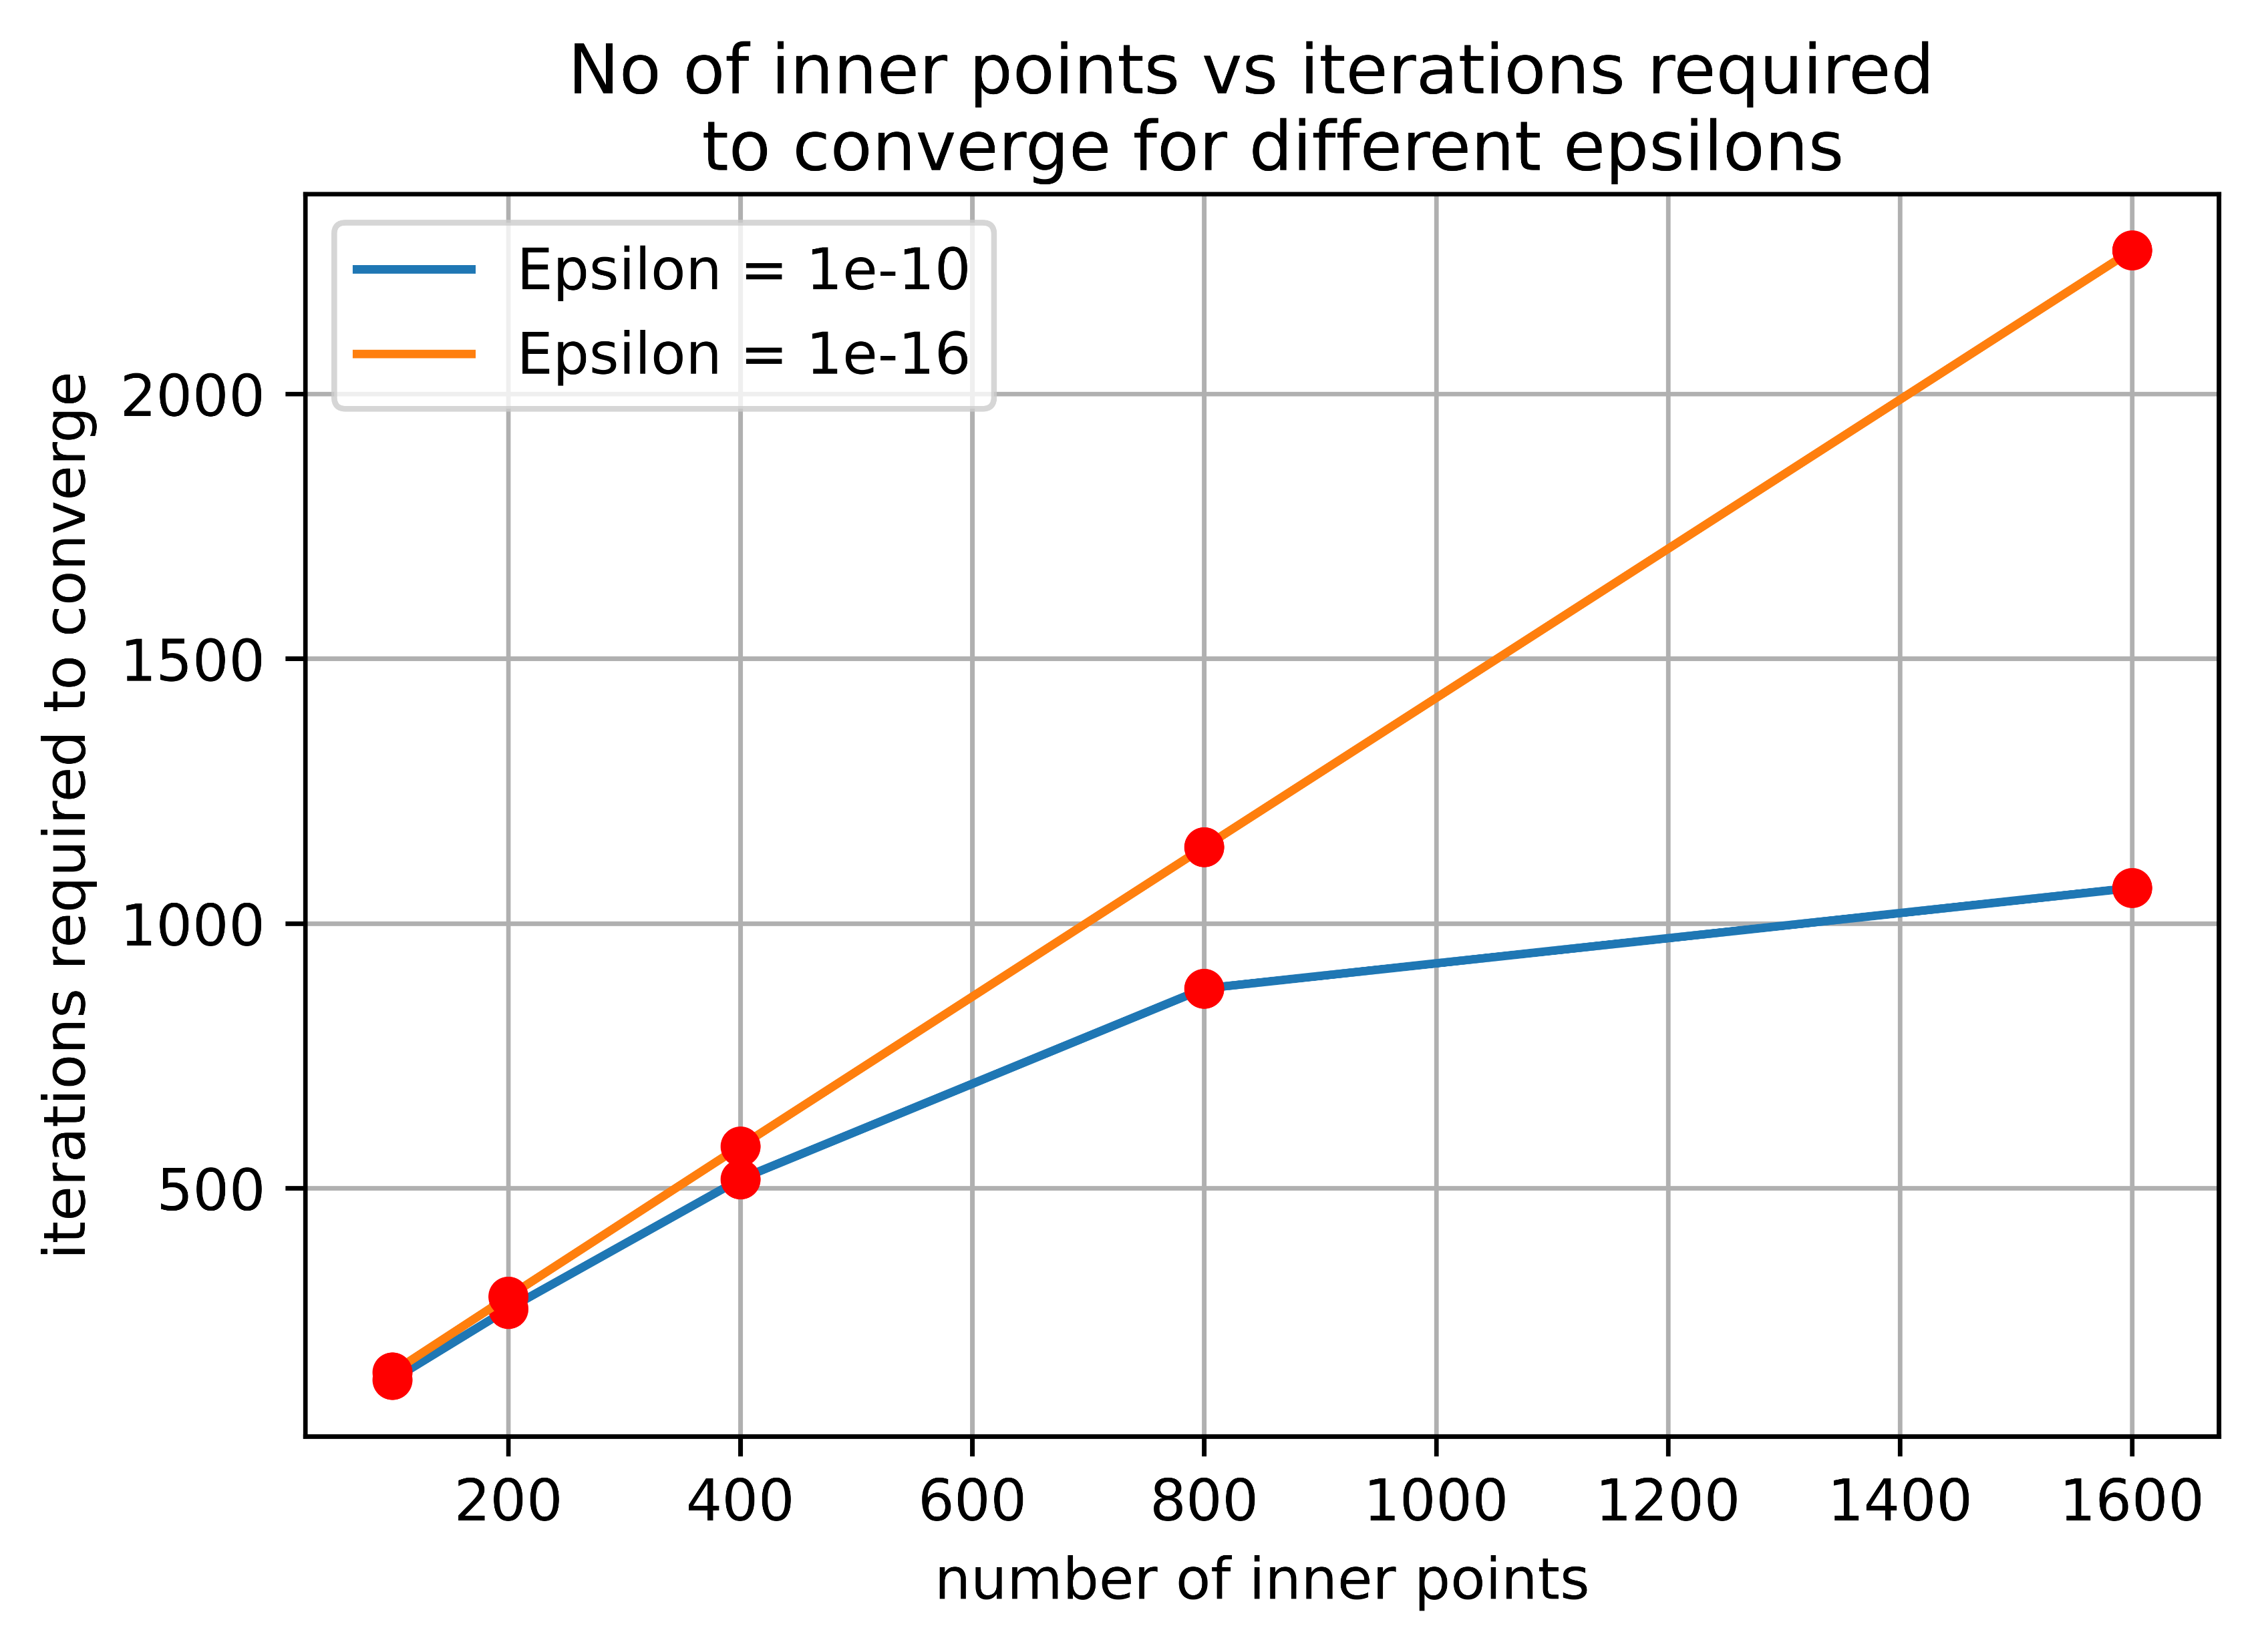
Observations and results
1. Effect of epsilon (Considered for sequential case.) continued
The number of iterations and the respective time taken in milliseconds is observed to grow linearly with the number of inner points (8 * number of inner points) but with the decrease in epsilon, the PCG solver takes lesser than twice the iterations by doubling the number of inner points especially with larger number of inner points.
The reason, I assumed may be the cache effects due to the growth in the volume of our problem with epsilon.

Slide 13
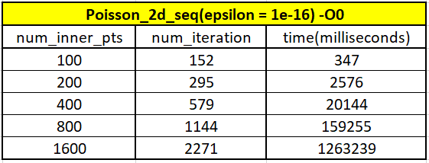
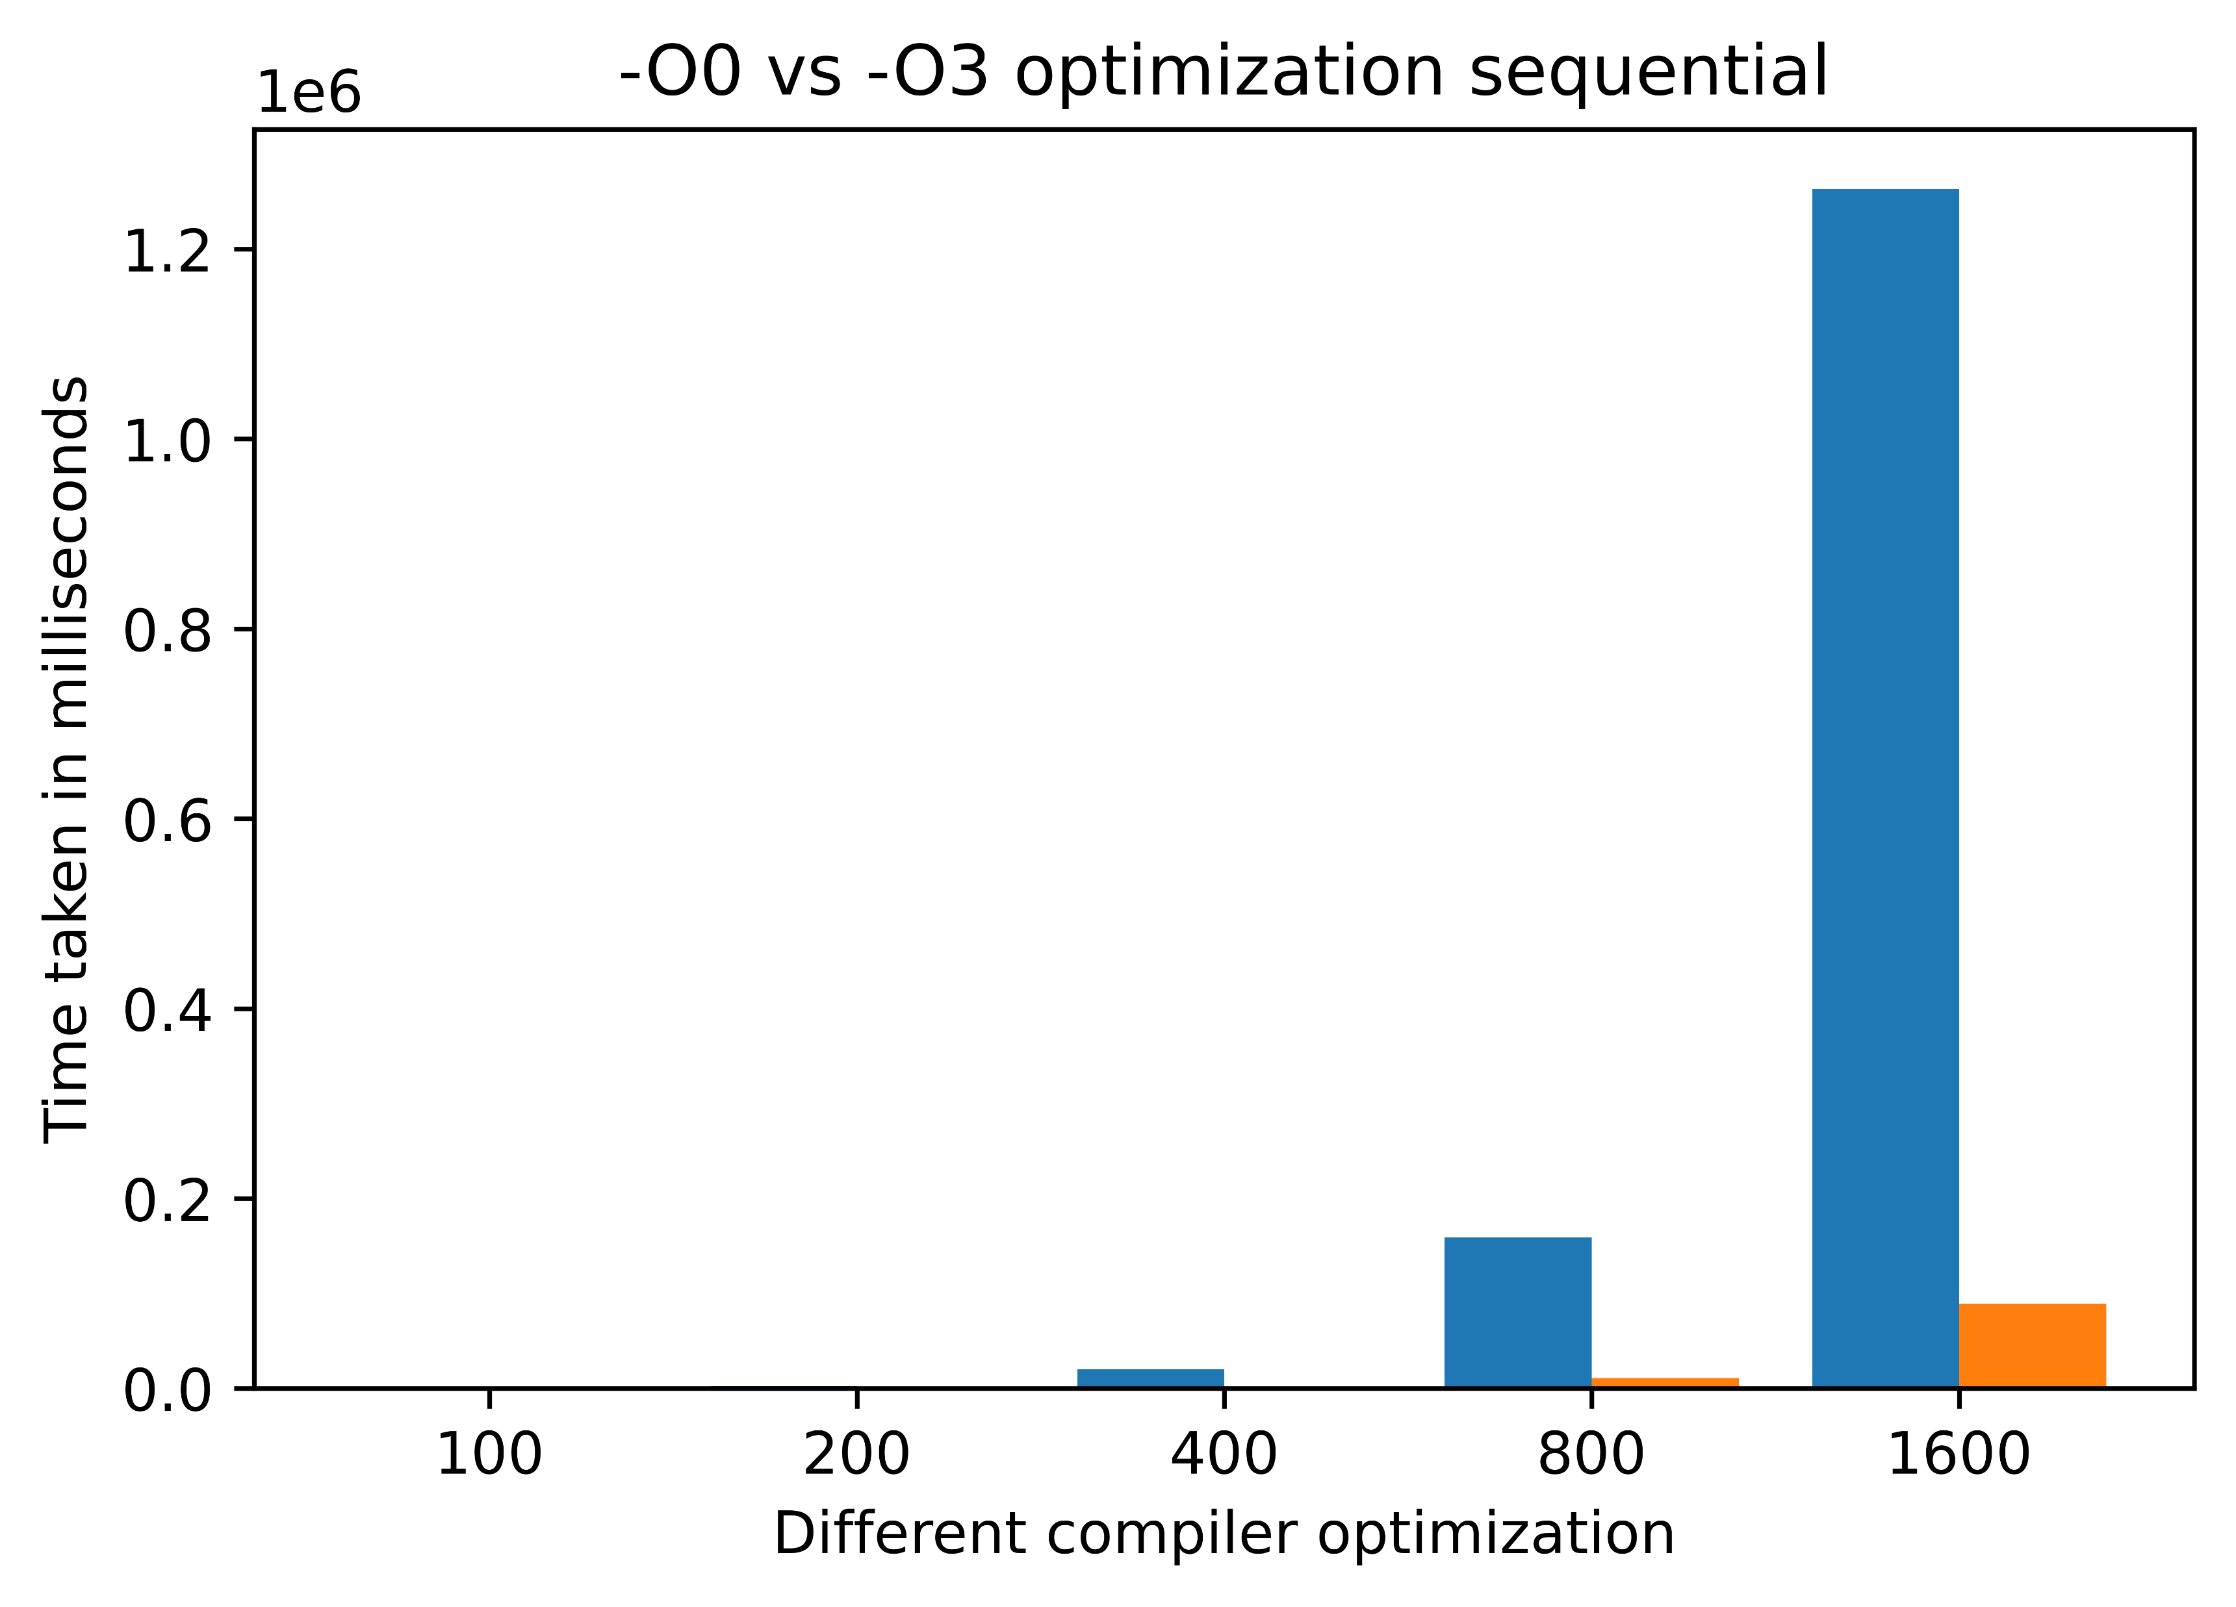
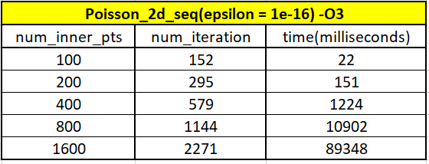
Observations and results
2. Effect of –O3 optimization (Considered for sequential case.)
The time taken for the same volume of computation reduces almost 16 – 17 times with –O3 optimization.

Slide 14
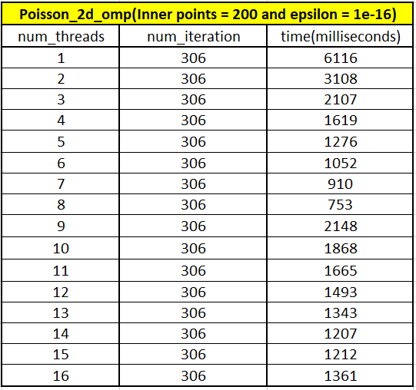
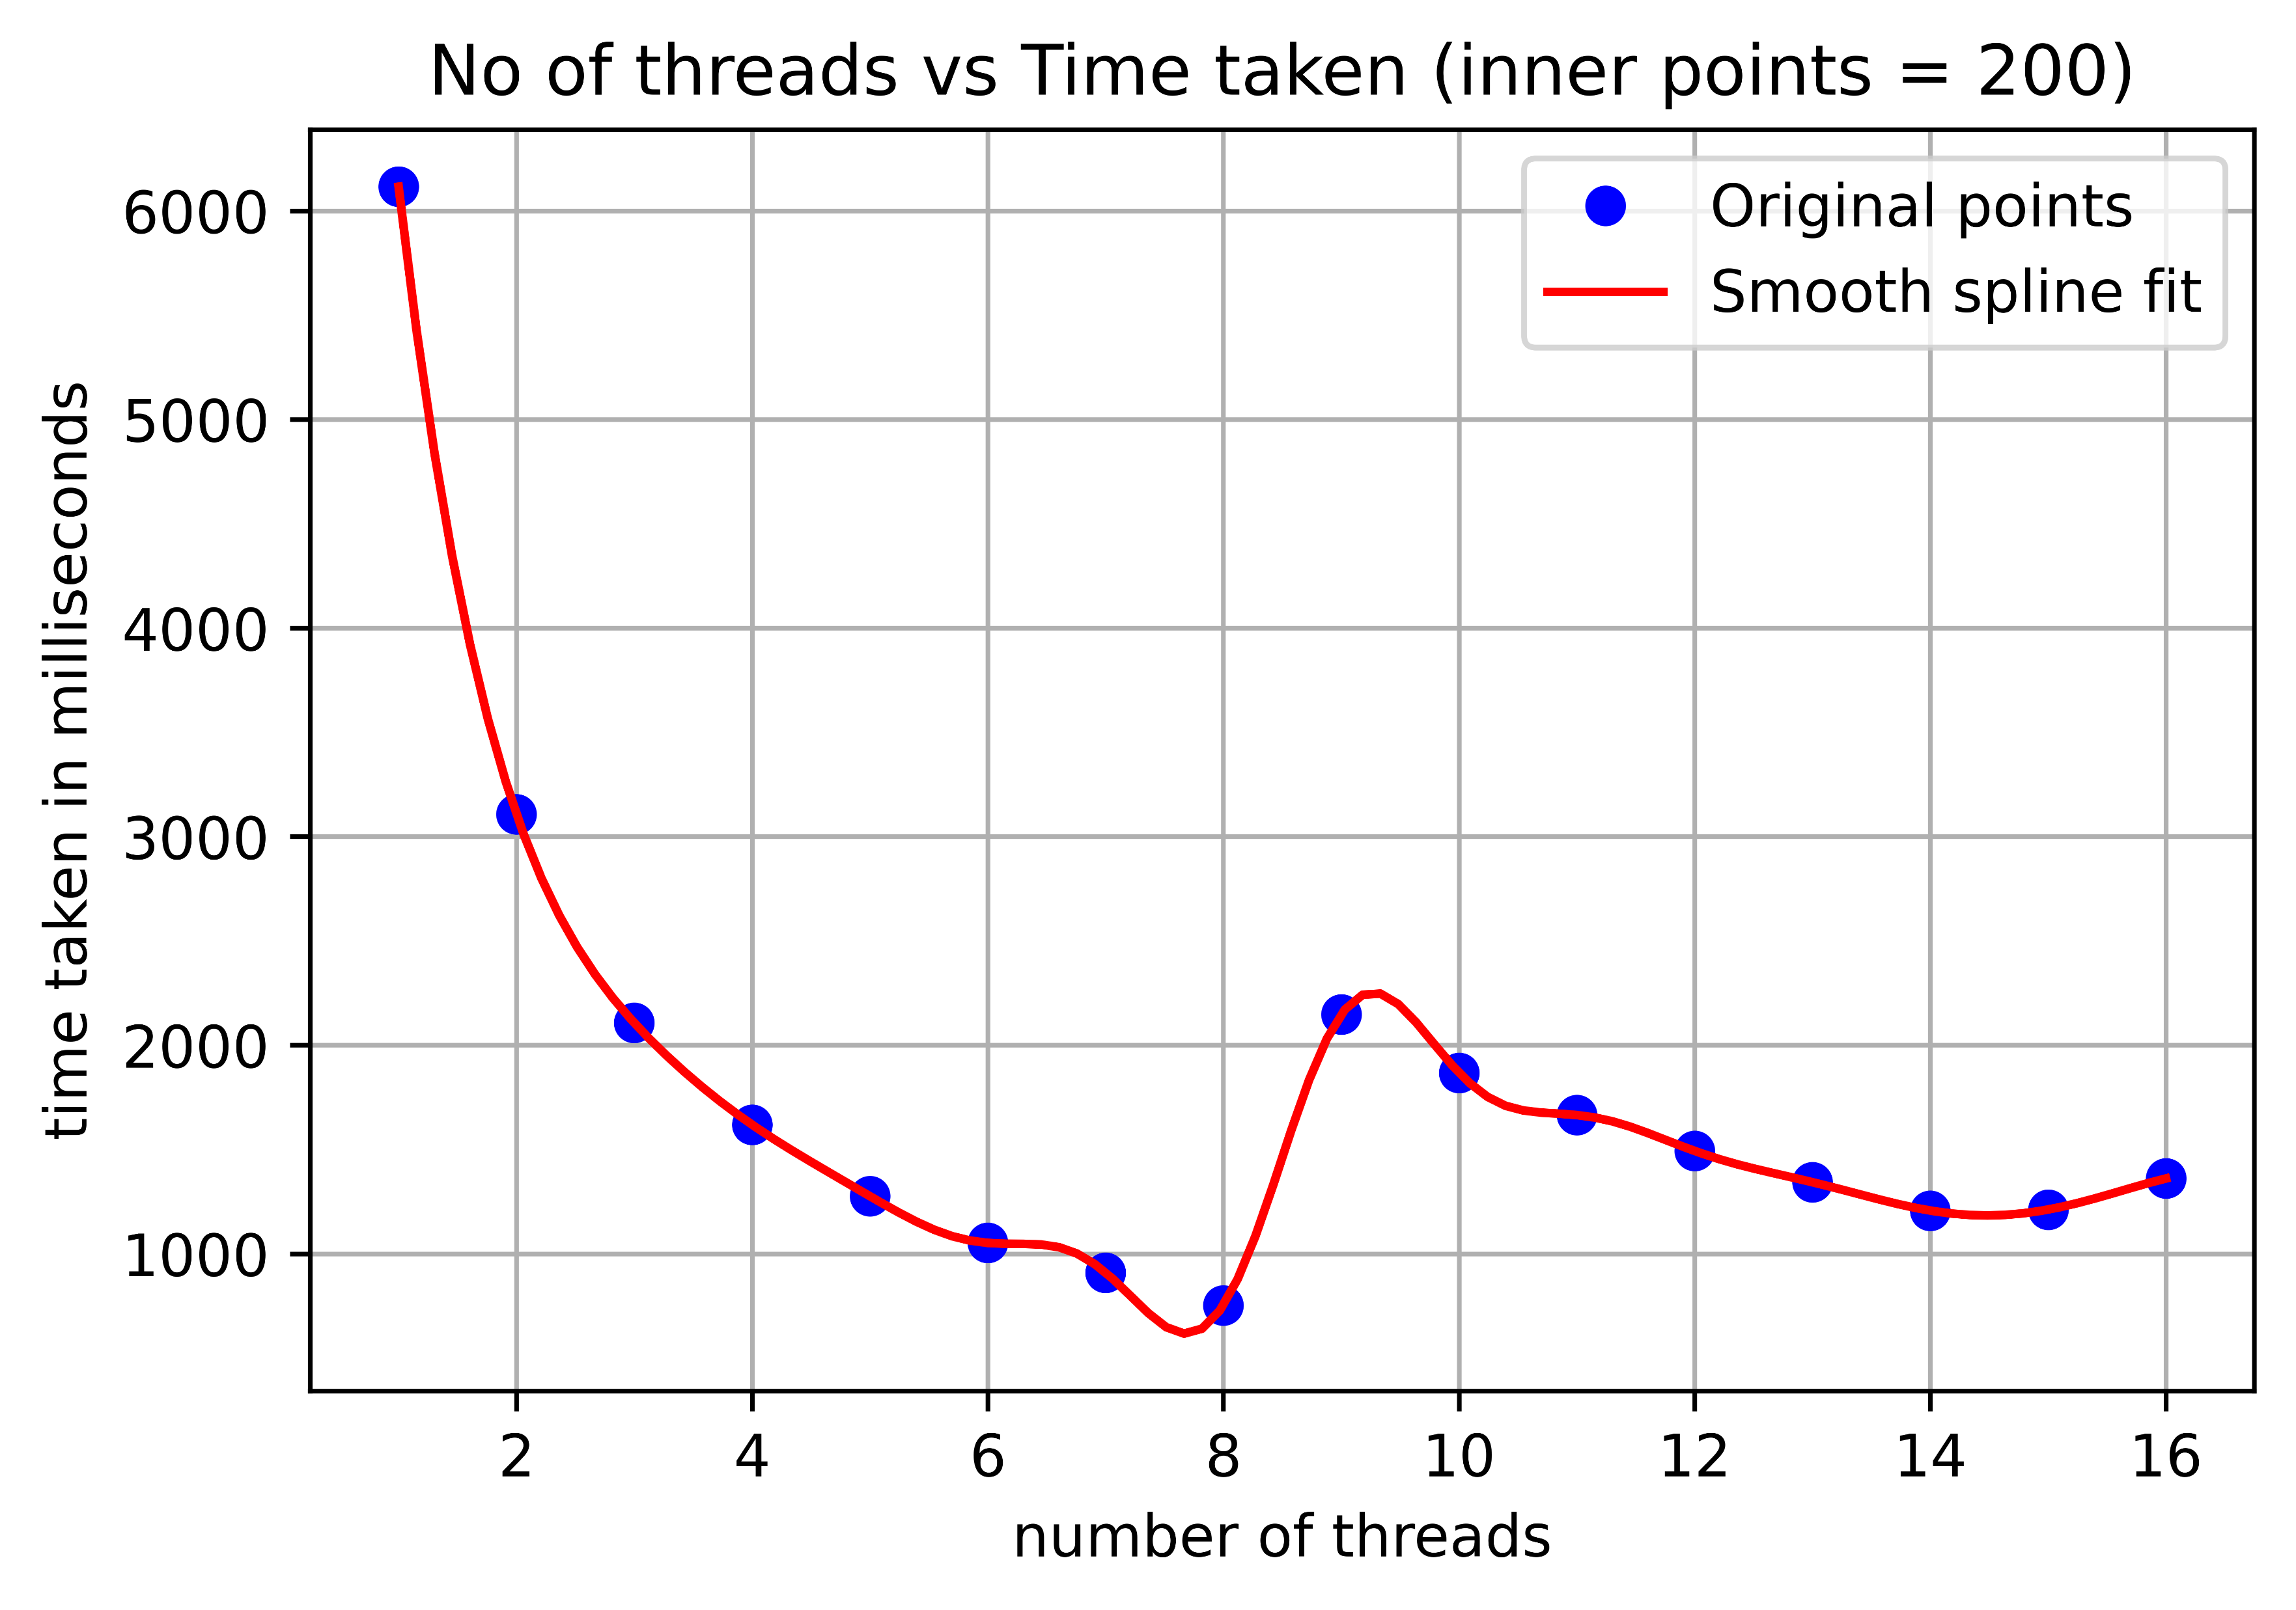
Observations and results
3. Speed up with number of threads.
Time taken for the computation almost reduces half by doubling the number of threads up to threads equal to total number of cores (except for some parallel overhead.) and there on increases again with the further increase in the number of threads and saturates.

Slide 15
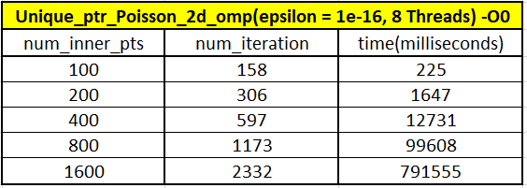
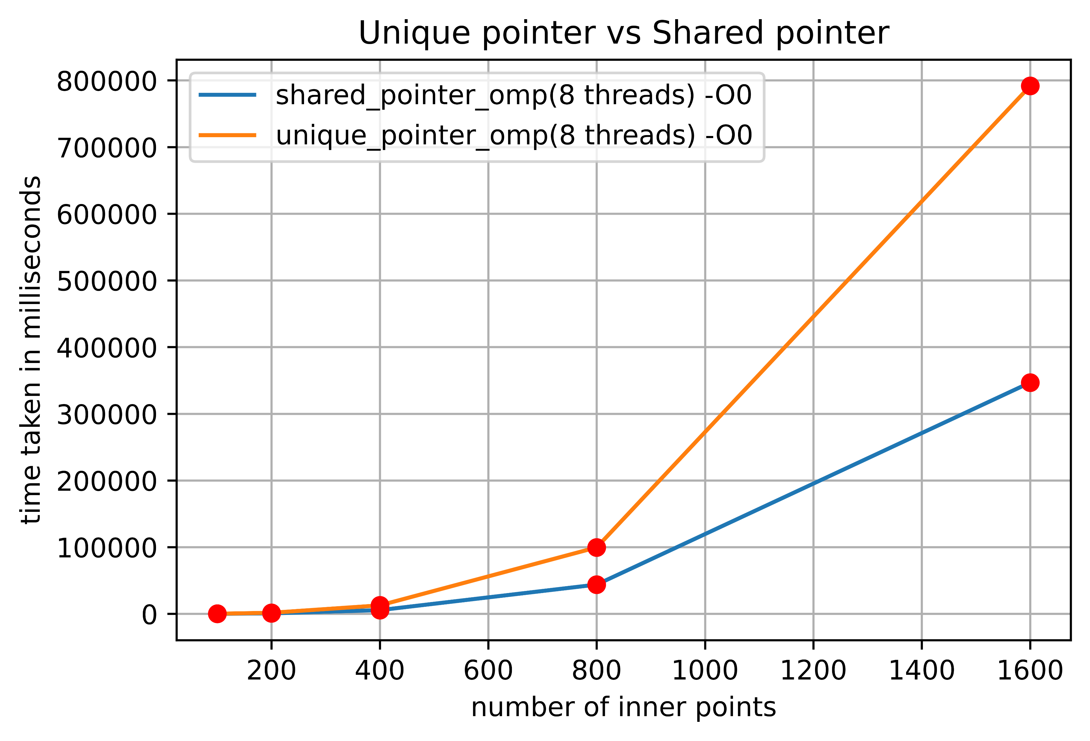
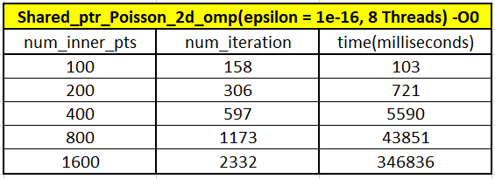
Observations and results
4. unique_ptr vs shared_ptr with no compiler optimization.
Shared_ptr performs better for the same volume of the problem than the unique_ptr without any optimizations but performs the same with –O3 optimization.

Slide 16
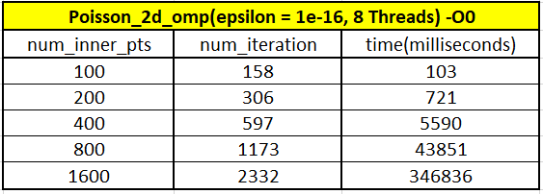
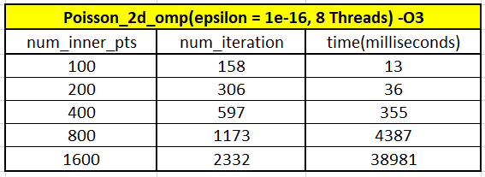
Observations and results
5. General comparison for max performance (-O3 and shared_ptr).

Slide 17
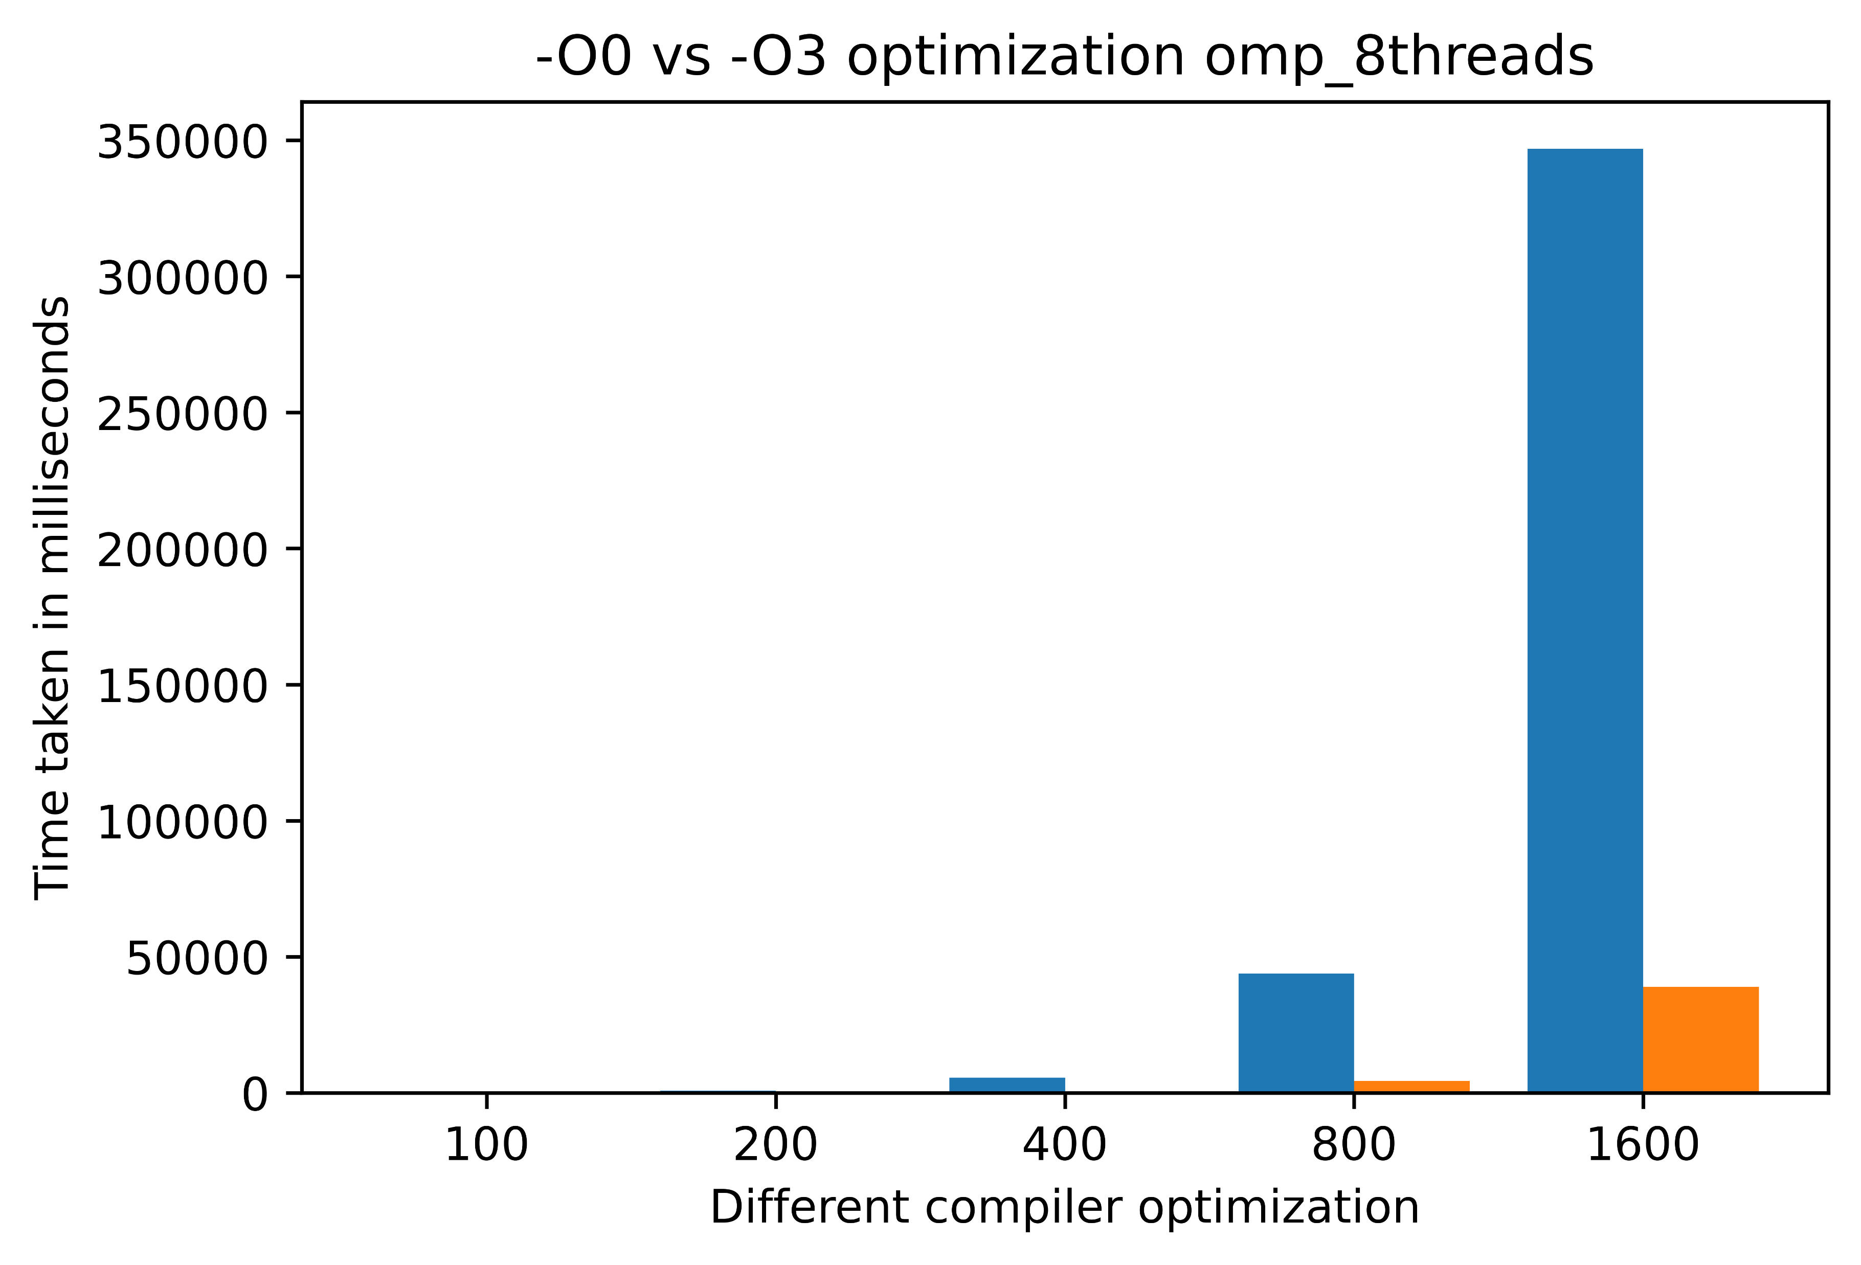
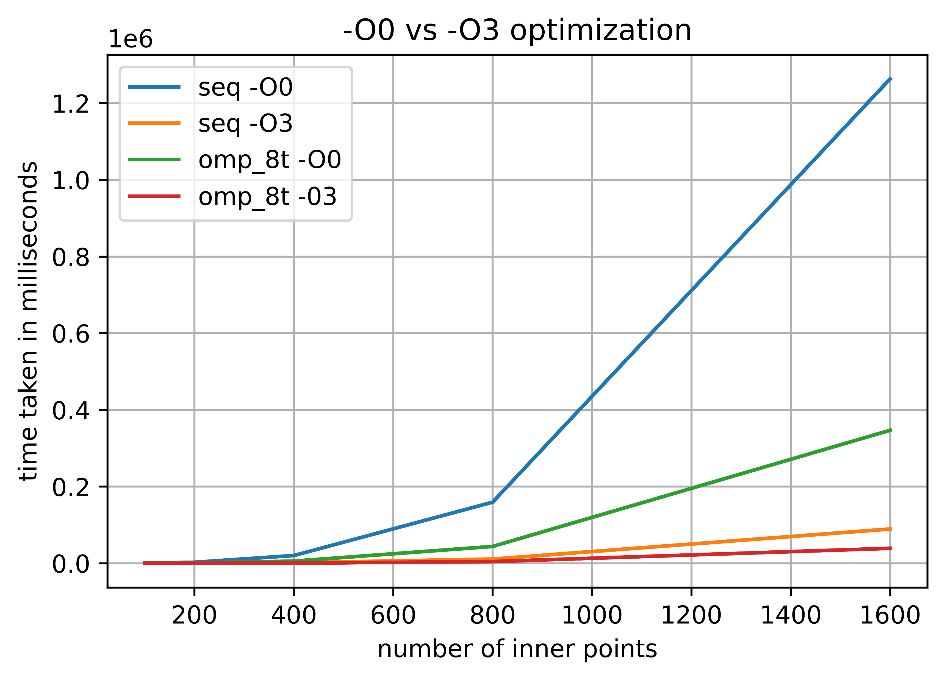
Observations and results
5. General comparison for max performance (-O3 and shared_ptr) continued.
I can clearly see the winner ☺.

Slide 18
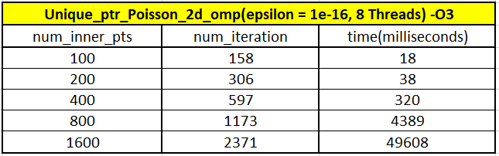
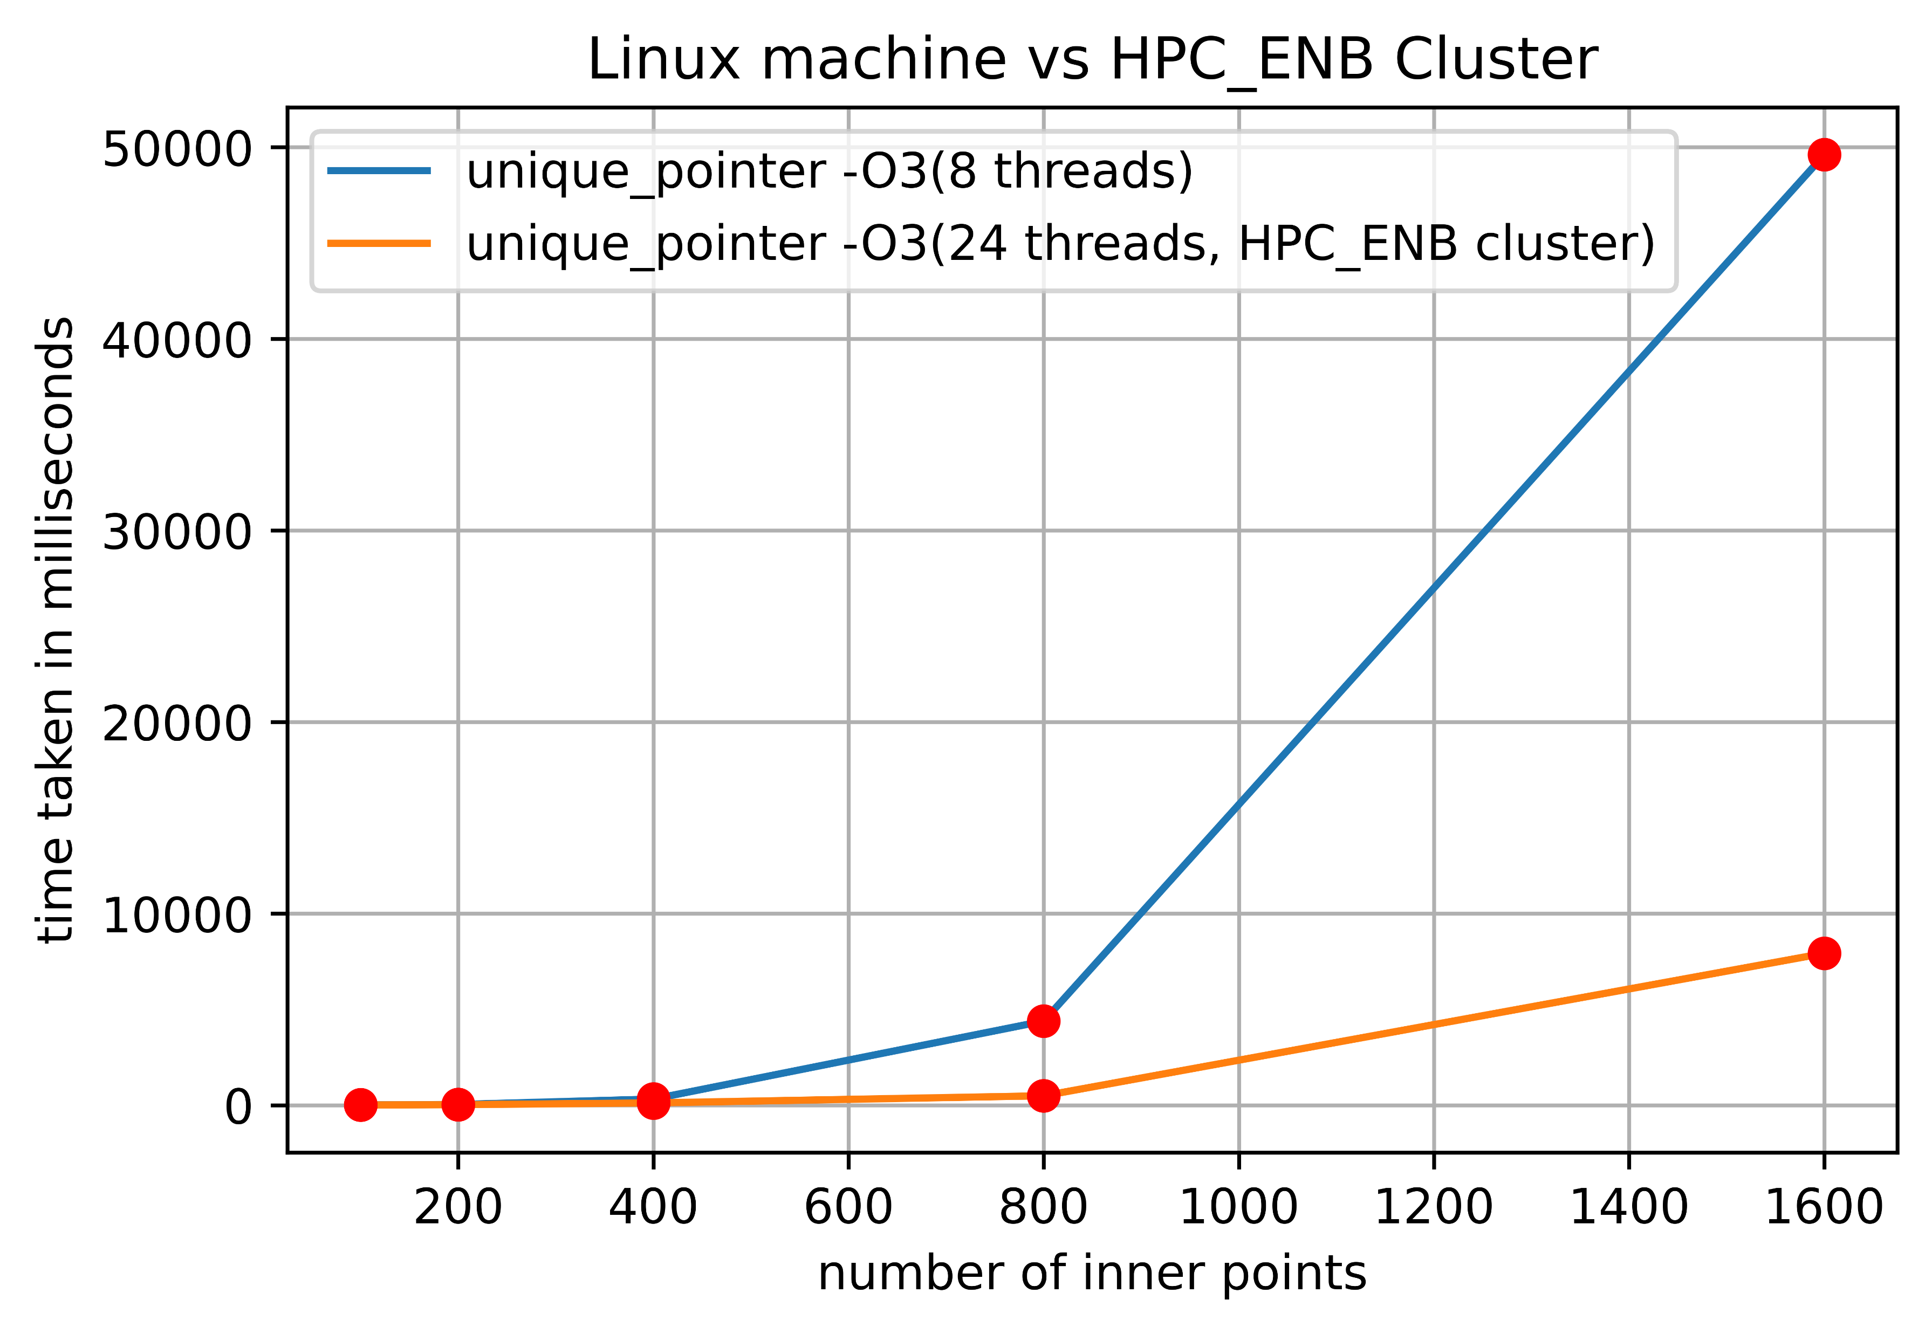
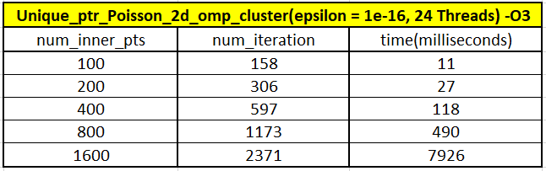
Observations and results
6. Remote server 8 threads vs HPC_ENB Cluster 24 threads (unique_ptr with -O3 ).

Slide 19
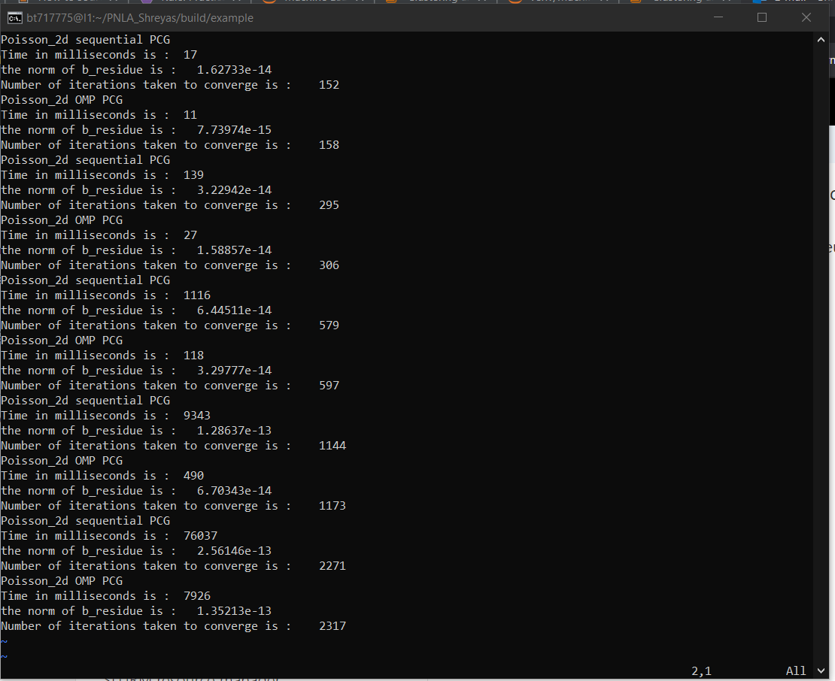
HPC_ENB Cluster slurm batch output

Slide 20
Experiences and lessons learned
Keep the implementation simple, modular and clean.
Have a plan regarding the sequence of implementations and adapt a generic implementation.
Good documentation for code reuse and maintenance.
Command prompt is better that VS Code in built terminal ☺.

Slide 21
Thank you.

